Slide 1
TRACK 2: KANTAR DATA VISUALIZATION
The Office of the CTO

Slide 2
WHY ? KANTAR DATA VISUALIZATION

Slide 3
Background: Visualization Platforms - Ready to feel inspired?
Intuitive way of Data Representation
Interactive visualization: Narrow down to the details what we need using slice and dice ( unstructured, structure, non-additive, etc)
Quick access to data: The rate of technology obsolescence has dramatically accelerated over the last few years, going for 10+ years for an ERP system to now barely 12-18 months in the data space
Action to data: Our products will change substantially over the next few years, going from currently “asking” ( survey-based work) to “listening/inferring” ( Behaviours, neuroscience, etc) we need to allow technology flexibility to our business

Slide 4
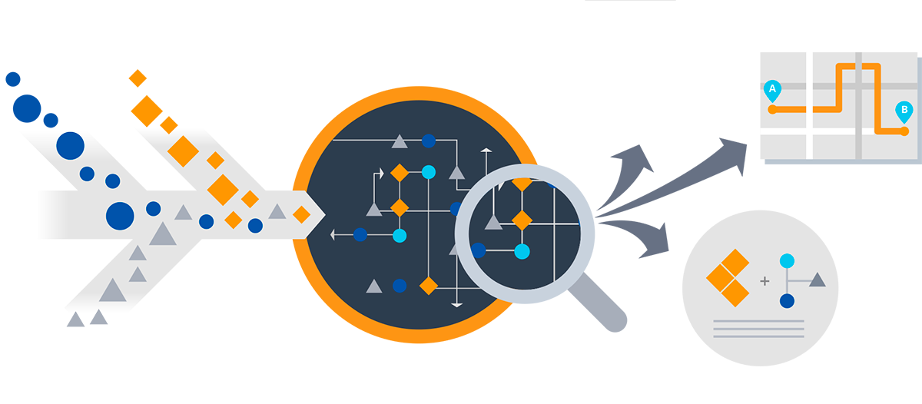

Connecting everything together….
DATA VISUALIZATION
DATA
SCIENCE
Use rich visual design, interactive and intuitive reporting solutions distributed as catalog-based personalized services to Brands; improve time to insights, decision making and monitoring outcomes
Apply analytical approach to combine, correlate, and compute any complexity of data.
DATA FACTORY
Data Factory is a process to ingest any data, process & analyze at any time, store & distribute any volume and distribute to any device/system. Manage data efficiently in a factory model to drive efficiencies
Personalized platform for clients to view data, reports, insights and actions.
CLIENT DELIVERY PLATFORM

Slide 5
The Big Picture
DATA
FACTORY
DATA
SCIENCE
VISUALISATION & CLIENT DELIVERY
This is where the value is
Kantar has excellent statisticians, so - We cover Graphical models ( Degression models) - However we have gaps in other algorithm families – notably
- Neural networks
- Logic/Rule based (expert system)
- Genetic
- Support vectors
We should also experiment cross-family algorithms
Engineered for:
- Flexibility
- Re-use
- Repeatable Quality
- Important layer to visualise and data client delivery
- Economies of scale

Slide 6

Why need for common data visualization platform for Kantar?
Addressing business needs to drive agility and better time to Market
“The Differentiation is not in the data itself (content, quality) but in the algorithms used to extract Insights ”
Data Factory promotes consistency, scale, and decreasing unit cost; an immediate focus; and a culture that values quality and revenue above all else.
Data Scientists to focus on which algorithm provides the best results, rather than data quality, integration
Allow for flexibility – avoid proprietary lock-in data platforms vs Open and cloud platform
Look for a “best–of– breath” approach – avoid monolithic platforms that answers all our requirements

Slide 7
WHAT CONSTITUTES KANTAR DATA VISUALIZATION
Data Visualization is a cloud-based data integration service that orchestrates and automates the movement and transformation of data: Compose and orchestrate data services as scale.
Just like a manufacturing factory that runs equipment to take raw materials and transform them into finished goods, Data Factory orchestrates existing services that collect raw data and transform it into ready-to-use information

Slide 8
Typical Use Cases that can be implemented through Data Factory
BUSINESS / CATEGORY / VISION & STRATEGY
BRAND STRATEGY
INNOVATION
BRAND EXPERIENCE
GO TO MARKET STRATEGY & EXECUTION
ORGANIZATION
PERFORMANCE OPTIMIZATION & PREDICTION
Win with Shoppers
and Customers
Engage the organization and build capability
Measure KPI’s impact and maximize ROI
Where to play
What to stand for
How to disrupt and renew
Engage the consumer
Enabling Brands to decide on right strategy aligned with market direction by bringing in 3rd party data; ability to do a CPEST & SWOT analysis to finalize market disruptive strategy for Brands
Brand strategy is derived from Brand's Line of Business Status Quo and ability to comprehend gaps.
Need a platform that captures critical data elements to decide on KPIs for enabling strategy formulation
Ensure profitable growth by experimenting with new ideas and leverage innovative platform to test the ideas. Finding next growth opportunity for Brands.
Do more with less and maximise Brand’s investment across touchpoints and ensure brands are meaningfully different
Create a winning and consistent experience with consumers, shoppers, customers, key influencers, the public and society by capturing Voice of Consumer by bring in social and extended data
Align the business and remove the silos
With so much data available, making sense of it to shape the future & select the right KPI’s
3rd Party data consolidation with Brand Data for Insights
Data Catalogs for addressing curremt business problems
Innovative Tier 2 platform for Ideation & Hypothesis testing
Bring data from varied touch points real time to personalize
VOC through structured, unstrutured and streaming data
Build capabilities to unify and remove redundancies
Data Visualization platform for strategic imperatives

Slide 9
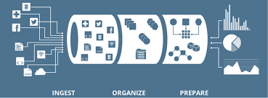
Business capabilities channelized through Data Factory
BUILDING BLOCKS
1
Data
Ingestion
2
Market Place
BUSINESS CAPABILITIES
3rd Party data consolidation with Brand Data for Insights
3
Data Catalogue
VOC through structured, unstrutured and streaming data
12
Cost
Allocations
VALUE CHAIN
INGESTION
Data Catalogs for addressing curremt business problems
11
Data Operations/ DevOps
TRANSFORM & ANALYZE
4
Discovery
Build capabilities to unify and remove redundancies
Innovative Tier 2 platform for Ideation & Hypothesis testing
Data Visualization platform for strategic imperatives
10
Reference / Master Data
5
Data
Processing
Bring data from varied touch points real time to personalize
Real Time
PUBLISH
Ingest
Transform
Publish
Batch
9
Data Security
6
Business Cost
&
Value
8
Data Testing & Reconciliation
7
Data
Monitoring Process Console

Slide 10
Business capabilities channelized through Data Factory
BUILDING BLOCKS
1
Data
Ingestion
2
Market Place
BUSINESS CAPABILITIES
3rd Party data consolidation with Brand Data for Insights
12
Cost
Allocations
3
Data Catalogue
VOC through structured, unstrutured and streaming data
INGESTION
Data Catalogs for addressing curremt business problems
TRANSFORM & ANALYZE
4
Discovery
11
Data Operations/ DevOps
Build capabilities to unify and remove redundancies
Innovative Tier 2 platform for Ideation & Hypothesis testing
Visualize
+ decide
10
Reference / Master Data
5
Data
Processing
Data Visualization platform for strategic imperatives
PUBLISH
Bring data from varied touch points real time to personalize
9
Data Security
6
Business Cost
&
Value
8
Data Testing & Reconciliation
7
Data
Monitoring Process Console
Real Time
Ingest
Transform
Publish
Batch

Slide 11


Building Blocks for Data Factory
GET THE DATA FOUNDATION
RIGHT
INDUSTRIALIZE
DATA MOVEMENT
AGILITY IN ADDRESSING
BUSINESS NEED
1
Data
Ingestion
2
Market Place
4
Discovery
12
Data Asset Monetization
5
Data
Processing
7
Data
Monitoring Process Console
10
Reference / Master Data
3
Data
Catalogue
8
Data Testing & Reconciliation
6
Business Cost
&
Value
11
Data Operations/ DevOps
Governance
Execution
Discovery

Slide 12

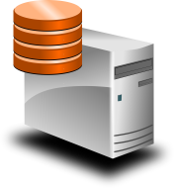









Conceptual Solution View
Kantar Data Repositories
BU/Functional
Datastores
Enterprise
Data Warehouse
Other Systems
Data Delivery
Analyze
Data Access/Exchange
ABSTRACTION LAYER
Data sources
S
E
M
A
N
T
I
C
L
A
Y
E
R
Data Capture
Search (Lucene)
SharePoint/Graph API
Services (API)
JDBC/ODBC
Meta information
Metadata
Advanced Analytics
(Azure Market Place)
Data
Scientists
Unstructured Data
Fast data
(Azure Event Hubs & HD Insights)
Data Analytics & Insights
Azure Machine Learning
HD Insights - Mahout
SQL Analysis Services
Master data
Data processing
Reference data
Data Analysts
Self-Service Data Discovery Platform
(Power BI)
Machine Data
Data quality processing
Integration & Transformation
Function processing
Master/reference data referencing
Streaming data (Azure Event Hubs & Stream Analytics)
Rules
Logs
Files
Data Factory, Spark, HiveQL, PIG, Storm
Data quality routines
Azure HD Insights
BI Reports & Planning Users
Enterprise
Structured
data
Data landing and hosting
BI Reports/Dashboards (Excel BI)
Data storage
(Azure Blob, Data Lake)
Quick Access Storage
(Azure HD Insight-HBase,
Azure Document dB)
Functions
Batch data
(Data Factory)
Workflows
Operations
Users
Data security
(Authenticate, Authorize, Encrypt)
Relational Storage/Access
(Azure SQL dB, Azure SQL DW)
Security
Operational Reports
(SSRS)
Web data
Data Governance
Error Handling & Reconcilliation
Auditing
Orchestration
Operations
Solution Consideration
Aligns to reference architecture
Pattern based development
Universal data access, Mixed workflows
Scale Out Architecture
Complements Hadoop & Conventional systems
Reusability of solution tenets by different use cases

Slide 13



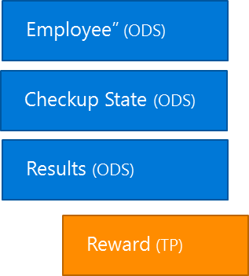

Reference Architecture
DATA SOURCES
INGEST
PREPARE
(normalize, clean, etc.)
ANALYZE
(stat analysis, ML, etc.)
PUBLISH
(for programmatic consumption, BI/visualization)
CONSUME
(Alerts, Operational Stats, Insights)
Kantar Global Data Source
Azure Functions
HDI Custom ETL
(Aggregate/Partition)
HDI Custom ETL
(Classification & Regression)
RDBMS
Master Data
Pipeline
Bot Application
APIs / Services
Files
10
01
Azure Storage (Blob / File / Table / Queue)
Intent Handling
Power BI
Data Stream
Message Response
Web
Telemetry
Event Hubs
Stream Analytics
(real-time analytics)
Machine Learning
(Anomaly Detection)
Cognitive Services
Mobile
Data Lake
Knowledge Base
Bots
Data Lake Storage (Encryption at Rest)
Data Lake Analytics
Kantar Bus/Dept. Data Source
Logic Apps
Azure Key Vault
Azure SQL Data Warehouse
Azure SQL DB
Document DB
RDBMS
Master Data
Azure main subscription
Azure Active Directory
APIs / Services
10
01
Azure Storage
HDI Custom ETL
Streaming Data /
Real time Data
Files
Azure Analysis Service
Cold path Data
Data Lake Storage (Encryption at Rest)
Data Lake Analytics
Telemetry
Data link btw subscription
Application Insights Telemetry collects assets data, effectiveness and technical information
Azure individual subscription

Slide 14
Kantar Data Factory Capability Matrix
Op Brand: | Kantar
Data Sources
Support a large range of data sources | Has been incorporated into the design and will support structured and unstructured data sets, flat files, delimited data, databases, etc.
Will support both real time and batch data acquisition | Both are supported
Scale both in terms of data and users | Microsoft Azure environment is built to easily scale up and scale out as well.
Pay per use base | Provided by Azure capability with ability to charge per project or OpCo if needed
Data Ingest
Provide streaming data capability inbound and outbound | Has been incorporated into the design through Event Hub, Stream Analytics, Storm, Spark Streaming. The components will be implemented based specific use case requirements
Framework services for monitoring, data transformation, data quality | Azure Data Factory (ADF) can be monitored through managed Azure setup. Customised ADF synchronization will give more control on end to end tracing. Metadata driven transformations, online data profiling, bad record capturing and maintaining data quality is possible.
Data Traceability / lineage | Azure Data Catalogue will enable traceability.
Data Processing
Can perform data transformation for structured and unstructured data | Yes – Azure HD Insights will transform both structured and unstructured datasets.
Proactive loading of commonly used sources | Connectors are provided for proactive loading. Underlying schema is elastic and stretchable to accommodate new data without having predefined schema and the combination of structure and unstructured data storage.
Data Exploitation
Support for multiple databases | Yes – a wide range of Microsoft and non-Microsoft databases can be supported
Integrate with existing visualisation tools | Easy integration using Azure ML web service so a wide range of non-MS products can be supported

Slide 15
HOW? EXECUTION OF KANTAR DATA FACTORY & PLAN

Slide 16
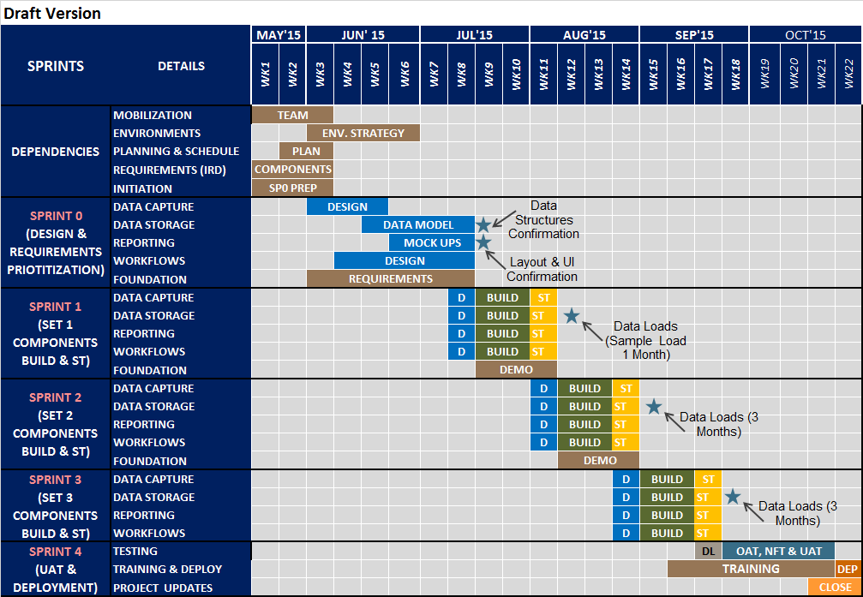
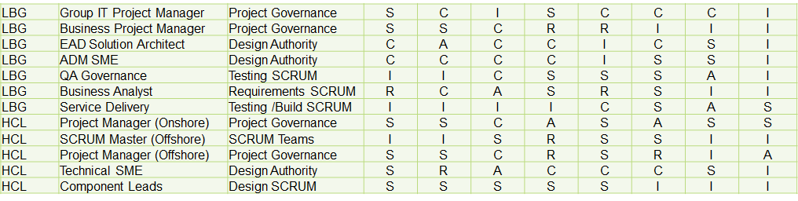
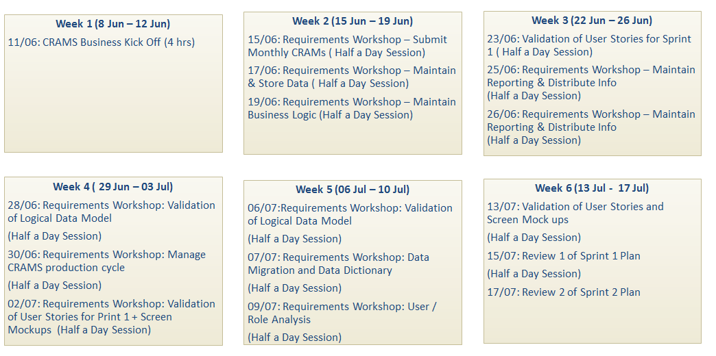
Data Factory Program
Program Structure
Plan On A Page
RASCI
Resource Schedule
Kantar Data Factory already live for “Data For All”
Pipeline for purchase data ( KWP)
Pipeline for attitudinal data ( KM TGI)
Pipeline for TNS connected life dataset
Span of control
Joint workstreams
Single reporting
Plan Overview
Key Dates
Milestones
Role definition
Point responsibility
Clear definitions
Expectation on Time needed from Business / OpCo SMEs
Constraints
Mode of Collaboration
Release 1: Data Factory Genesis
Component 1: Common Architecture Framework (CAF)
Component 2 : Data Ingestion Set Up & Onboarding Readiness (DIOR)
Component 3: Market Place & Data Catalogue (MAP)
Component 4: Data Factory Operations (DFOps)
Component 5: Benefits Framework (WoV)
Release 2: Data Factory Gold
Component 6: Attribute Coding & Reference Data (GARD)
Component 7 : Device Graph Mapping (GraM)
Component 8: Single Brand View (SBV)
Release 3: Data Factory Utility
Release 4: Data Factory Premium
Component 9: Data Asset Monetization (DAM)
Component 10 : Discovery -Data As A Service (DAAS)
Component 11: Data Monitoring Process Console (DPC)
Component 12 : Data Testing & Reconciliation (DTeR)

Slide 17
Prioritization of Data Factory
GET THE DATA FOUNDATION
RIGHT
INDUSTRIALIZE
DATA MOVEMENT
AGILITY IN ADDRESSING
BUSINESS NEED
Release 1 & 2
Release 4
Release 3
Opco | Project | Timeline | Priority
XXXXXX | XXXXX | XXXXX | XXXXX
Opco | Project | Timeline | Priority
XXXXXX | XXXXXX | XXXXXXX | XXXXX
Opco | Project | Timeline | Priority
XXXXXX | XXXXXX | XXXXX | XXXXX
Governance
Execution
Discovery

Slide 18
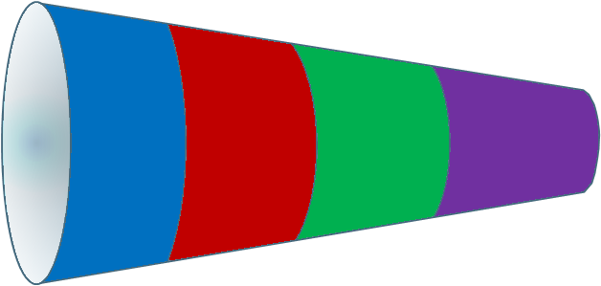
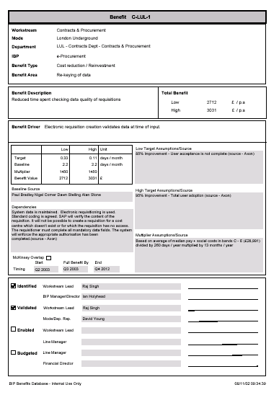
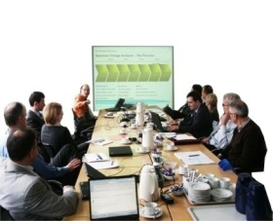
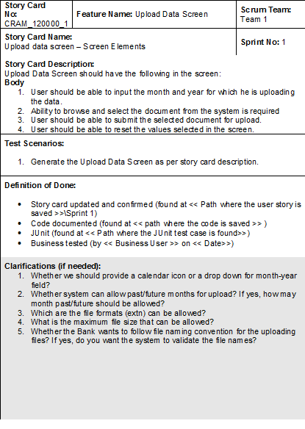
Component Build Approach (Release 1 – R1)
Pilot & Roll-out
Program Definition
Analysis & Design
Build & Test
COMPONENTS
REQUIREMENTS
CAF
DIOR
MAP
Define
Validate
Enable
Embed
Measurable Benefit
DFOps
WoV
Communications Strategy
Updates & Solution Backlogs
Mock Ups
Demo & Feedback
Requirements Definition (User Stories)

Slide 19

Program Structure
Approach is aimed at definition and review of critical aspects of program
FOCUS 1
FOCUS 2
FOCUS 3
Requirements Logical Grouping
Participate in Training of the product usage
Objectives
1. Requirements detailing
Final Confirmation of UAT Test Cases
2. Creation of User Stories
User Stories for Next Sprint
3. Validation of Screen Mock Ups
4. Confirmation of Sprint Scope
Mock Ups Confirmation & Design Validation
Validate demonstrations
Conduct UAT and provide final approval
Provide feedback for product backlog
Recommended Business workshop sessions
Requirements Logical Group
Definition of User Stories
Design Validations
Sprint Build Demo Validation & Feedback
Role based training
For internal use only

Slide 20
R1: Business Engagement Plan
Reqts. Baseline Grouping
Design
Solution Build
Validation & Productionize
Overall Programme Management, Plans, Governance, Risk & Issue Management
Requirement
Workshops
CAF
User Stories Sign-off
Architecture Description
Screen Mock Ups
Signoff
Solution Build and UT
Product Backlogs
Demo Sign Off
User Acceptance
Cutover
DIOR
Sprints Outline
#1
#2
OAT
#3
Solution Fixes
MAP
Data Dictionary
User Stories
DFOPs
Wire Frames & Design
Data Build
Trial
Data Load
Trial
Run
Data
Load
WoV
Sprint Plan
Data Migration
Stakeholder Engagement
Data Analysis & Understanding
Impact Analysis
Training
Development
Training
Change Management & Communications
Design Stakeholder
Engagement
Key
CTO Office
OpCo
Both
Critical Path for Data Factory – Business Areas
Requirements
Study
Workshops
Complete
CAF
Update
POCs / Mock Ups
User Stories 1
Build #1 Demo
User Stories 2
Build #2 Demo
User Stories 3
Build #3
Demo
Data Load
Support
UAT

Slide 21
R1: Sprint Team
OPCO CIO Sponsor
Enterprise Architect
CTO Office Product Owner
OPCO BA
OPCO BA
Project Manager
Project Manager
BA
Product Owner
Scrum Master
BA
Product Owner
Product Owner
OPCO BA
BA
Requirements Grouping & Baseline Scrum
Design & Build Scrum
Test & Production Scrum
Governance
HCL Lead Architect (Offshore)
OPCO
Data Analyst
Lead - UX
Data Analyst
Group CTO Office
Big Data PE
HCL Onsite
Baseline & Design Scrum
HTML/ Dotnet PE
Build Scrum
Test Scrum
HCL Offshore

Slide 22
R1: RASCI
Project Team |  |  | Project Activites
Partner | Role | Primary Project Function | Requirements | High-Level Design | User-Story Design | Build & Unit Test | SIT& SAT | UAT | Production
Kantar | Product Owner* | Component Ownership | R | R | A | R | C | C | C
Kantar | OpCo Business Analyst | Design & Testing Scrum | R | A | R | C | C | R | I
Kantar | Enterprise Architect | Design Authority | C | R | C | C | C | I | S
Kantar | Project Manager | Project Governance | C | C | R | R | R | C | S
HCL | Lead Architect | Design Authority & Governance | R | R | A | R | C | C | C
HCL | Scrum Master (Onshore) | Project Governance | C | C | R | R | R | C | S
HCL | Business Analyst (Onshore) | Design & Testing Scrum | R | A | R | C | C | R | I
HCL | Data Analyst(Offshore) | Design & Testing Scrum | C | R | C | C | C | I | S
HCL | Product Engineers | Build & Testing Scrum | I | I | C | R | R | R | R
* - Product Owner can be from Kantar or HCL.

Slide 23





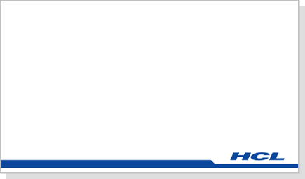


R1: A Day in the Life of OpCo BA / Representative
Plot
Kantar OpCo involvement in Release 1 solution.
Data for Kantar OpCo has to be sourced through DIOR @ MAP
Build feedback and updates go as product backlog.
Cast
Rebecca- OPCO BA (Insight)
Lou- Product Manager
Hayley- Enterprise Architect
David – HCL Technical SME
Aarti – HCL Business Analyst

Slide 24
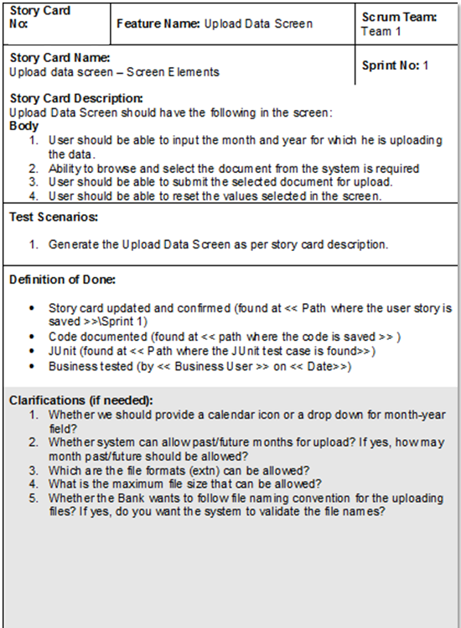
R1: User Stories Definition
Let me explain Lou and Hayley the requirement - let me start with “Data Screen”
I should be able to input the month and year for which data is being uploaded.
Probably ability to browse and select the document from the system is required
I should be able to submit the selected document for upload.
I should be able to reset the values selected in the screen.
Rebecca
2
Lou
Hayley
Aarti
Lou and Parvathy captures the requirement in notes which would form a input to User Stories Template
3
Hayley and Parvathy captures the requirement in notes which would form a input to User Stories Template
David
4
David captures the notes to check on feasibility of its design of components
1
Hi Rebecca, the agenda for workshop as I have sent a mail in detail is to understand the requirements of how data ingestion updates are captured and submitted

Slide 25
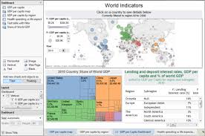
R1: Solution Build
User Story 1
“Good job; first set of functionality looks fine; though we have seen it with sample data. Some feedback on functionalities delivered”
3
Rebecca
Lou
1
“Rebecca, we have completed the build of 30 user stories and have completed our testing also, Can we have a demo session?”
4
We have captured the notes as these changes would go as product backlog and our user stories would be updated.
Lou
2
“Sure, please set up demo and I would invite my team.”
David
in conjunction with PM
5
Project Plan updated, backlog updated, design updated, user stories updated
Rebecca
Sprint 1 Build complete
Review

Slide 26
R1: Governance
Approach to project governance for the sprints focuses on timely deliverables at right quality. This is managed through
Governance forums, format and attendees
RASCI - Roles and responsibilities
Project reporting and control processes (Kantar Governance Process)
Deliverable list (Sprint Iterations)
Steering Committee
The governance structure for this project is based around a small number of joint and empowered forums. There will be continuity of attendance and these forums will ratify key decisions required by the project.
A weekly project Team Meeting will be the main forum for driving planning, constraints, issues, risks and decision making. Steering Committee will oversee the project on a monthly basis and this will be used as the ultimate point of escalation and decision making.
The programme will have daily scrum meetings to get an update on all components. The purpose of this forum is to provide a mechanism for getting key points to be discussed for the day as each day is critical for project.
Project Weekly Meetings
Scrum Meetings

Slide 27
R1: Approach
RELEASE 1: DATA FACTORY GENESIS
Product Management
The structure for the programme is based on the following key concepts.
OPCO involvement is key driver in shaping up Data Factory platform.
A Product Management layer will undertake key aspects of project covering both OpCO and CTO Office Architectural elements of the program.
Sprints will own the delivery of functional releases entailing key functional and non-functional build components.
Common Architecture Framework
Data Ingestion & Onboarding Readiness
Sprint 0
Sprint 3
Sprint 1
Sprint 4
Sprint 2
Market Place & Data Catalog
Data Factory Operations
Benefits Framework

Slide 28
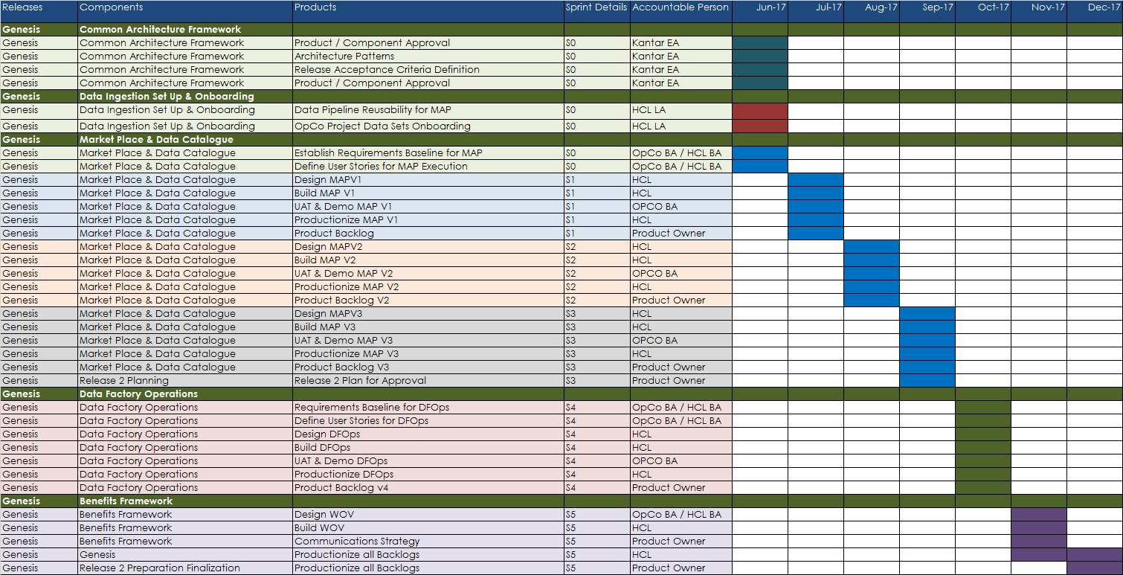
R1: Data Factory Genesis - Plan on A Page (POAP)

